Slide 1
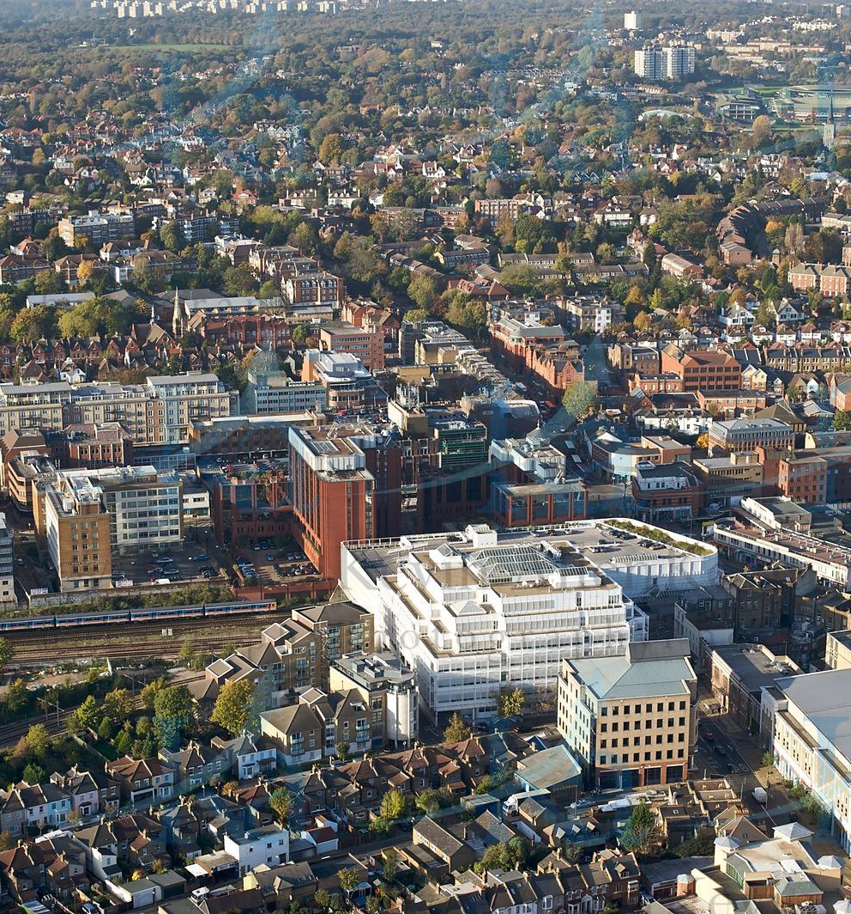
WELCOME to:
THE INAUGURALGENERAL MEETING
OF THE
WIMBLEDON NEIGHBOURHOOD PLANNING GROUP
25th January 2020

Slide 2
1. Welcome and opening comments – Jonathan Parker
2. What a Neighbourhood Forum is – Tony Burton
3. Why Wimbledon needs a Neighbourhood Forum – Rob Cowan / Suzanne Grocott
4. Next Steps - how we create a Neighbourhood Plan for Wimbledon – Jonathan Parker
5. Questions
6. Ten minute break for informal discussion and last opportunity before official business to register as a member.
7. Adoption of draft constitution
8. Election of Honorary Officers
9. Election of Steering Committee Members
10. A.O.B. – Vince Harris
INAUGURAL GENERAL MEETING
OF THE WIMBLEDON NEIGHBOURHOOD
PLANNING GROUP

Slide 4
Why Wimbledon needs a Neighbourhood Forum
Rob Cowan
INAUGURAL GENERAL MEETING
OF THE WIMBLEDON NEIGHBOURHOOD
PLANNING GROUP
INAUGURAL GENERAL MEETING OF THE WIMBLEDON NEIGHBOURHOOD PLANNING GROUP

Slide 5
Why Wimbledon needs a Neighbourhood Forum
Suzanne Grocott
INAUGURAL GENERAL MEETING
OF THE WIMBLEDON NEIGHBOURHOOD
PLANNING GROUP

Slide 6
Next Steps - how we create a Neighbourhood Plan for Wimbledon Jonathan Parker
INAUGURAL GENERAL MEETING
OF THE WIMBLEDON NEIGHBOURHOOD
PLANNING GROUP

Slide 7
INAUGURAL GENERAL MEETING OF THE WIMBLEDON NEIGHBOURHOOD PLANNING GROUP
Questions?

Slide 9
INAUGURAL GENERAL MEETING
OF THE WIMBLEDON NEIGHBOURHOOD
PLANNING GROUP
Adoption of draft constitution

Slide 10
INAUGURAL GENERAL MEETING OF THE WIMBLEDON NEIGHBOURHOOD PLANNING GROUP
Election of Honorary Officers:
Chair
Secretary
Treasurer
INAUGURAL GENERAL MEETING
OF THE WIMBLEDON NEIGHBOURHOOD
PLANNING GROUP

Slide 11
INAUGURAL GENERAL MEETING
OF THE WIMBLEDON NEIGHBOURHOOD
PLANNING GROUP
Election of the Members of the Steering Committee

Slide 12
A.O.B. Vince Harris
INAUGURAL GENERAL MEETING
OF THE WIMBLEDON NEIGHBOURHOOD
PLANNING GROUP

Slide 13
Thank you!
www.wimbledon-npg.org

